Slide 1
BLOOD DISORDERS
General objective
By the end of the session the student will be able to apply knowledge , skills and attitudes to promote health , prevent illness , diagnose , manage and coordinate rehabilitation of infants and adults suffering from common blood conditions

Slide 2
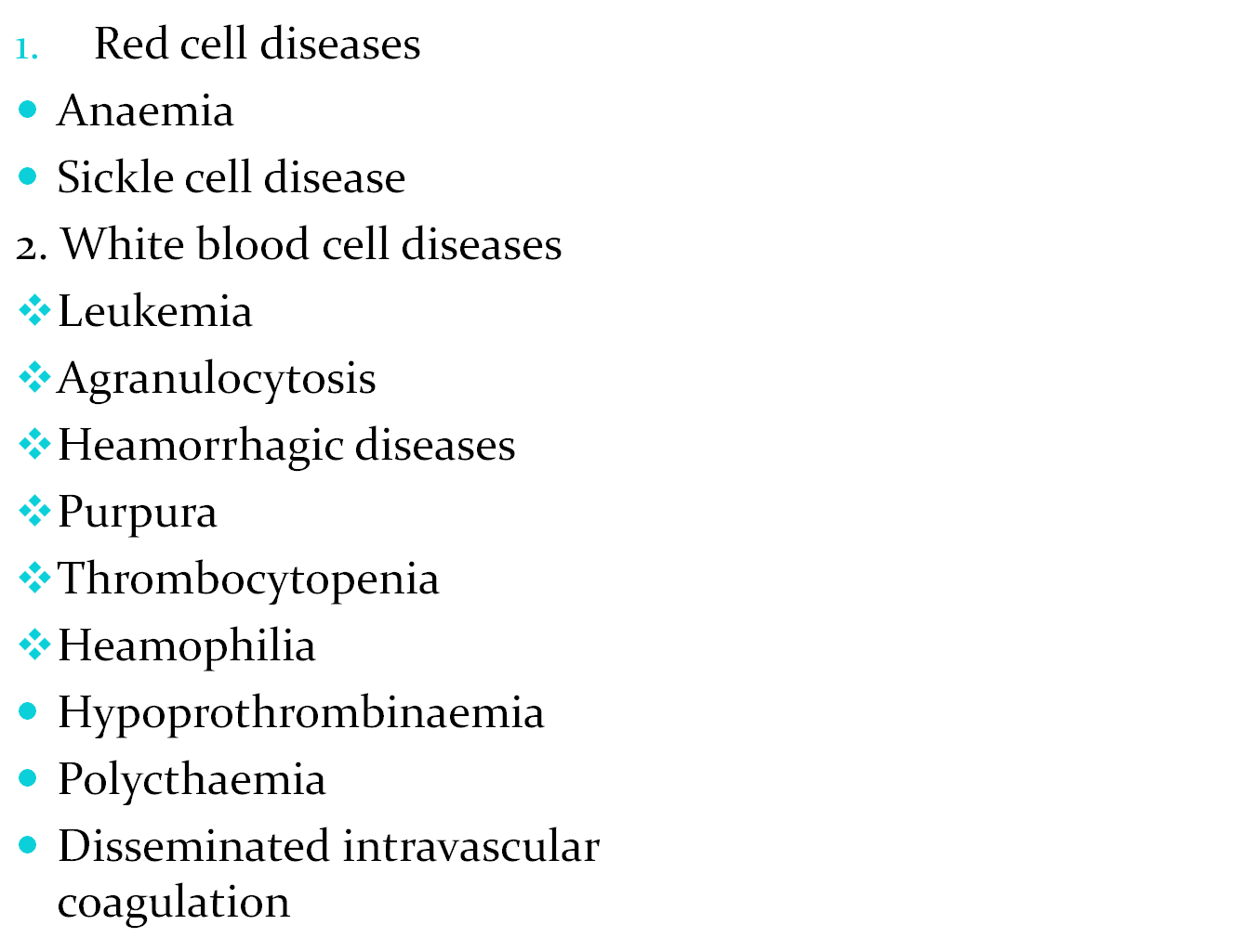
Contents

Slide 3
Objective
By the end of the session the students will be able to explain the characteristics of common blood diseases and provide relevant nursing care.

Slide 4
Anaemia
Anaemia is a deficiency in the number or quality of red blood cells. The red blood cells carry oxygen around the body, using a particular protein called haemoglobin. Anaemia means that either the level of red blood cells or the level of haemoglobin is lower than normal.These cells are the main transporters of oxygen to the organs in the body. Symptoms – like fatigue - occur because the organs aren't getting enough oxygen.

Slide 5
Main causes of anaemia
Dietary deficiency – lack of iron, vitamin B12 or folic acid in the diet.
Malabsorption – where the body is not able to use the nutrients in the diet, caused by conditions such as coeliac disease.
Inherited disorders – such as thalassaemia or sickle cell disease.
Autoimmune disorders – such as autoimmune haemolytic anaemia, where the immune cells attack the red blood cells and decrease their life span.
Chronic diseases – such as rheumatoid arthritis and tuberculosis.

Slide 6
Main causes of anaemia
Hormone disorders – such as hypothyroidism.
Bone marrow disorders – such as cancer or infection.
Blood loss – due to trauma, surgery, cancer, peptic ulcer, heavy menstruation, bowel cancer or frequent blood donations.
Drugs and medications – including alcohol, antibiotics, anti-inflammatory drugs or anti-coagulant medications.
Infection – such as malaria and septicaemia, which reduce the life span of red blood cells.

Slide 7
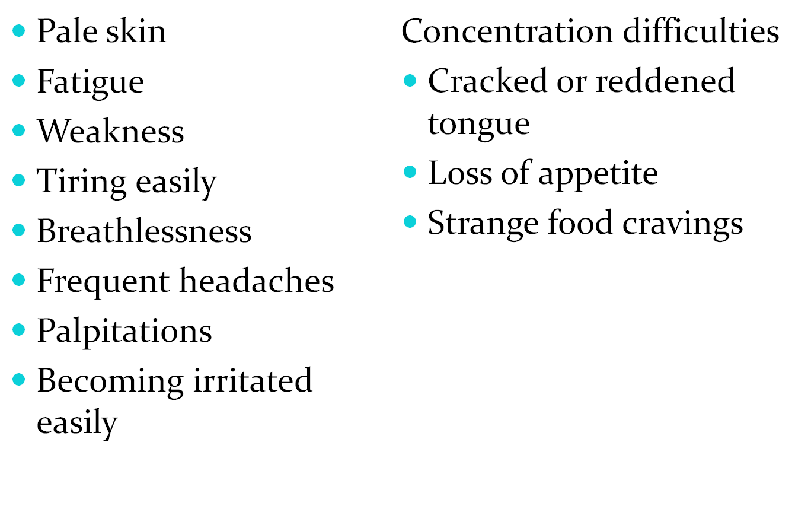
Signs and symptoms of anaemia

Slide 8
Diagnosis of anaemia
Medical history – of any chronic illnesses and regular medications
Physical examination
Blood tests – complete blood count and blood iron levels, vitamin B12, folate and kidney function tests
Urine tests – for detecting blood in the urine
Gastroscopy or colonoscopy
Bone marrow biopsy
Faecal occult blood test – examining a stool sample for the presence of blood.

Slide 9
Treatment of anaemia
Vitamin and mineral supplements – in the case of deficiency.
Iron injections – if the person is very low on iron.
Vitamin B12 (by injection) – required for pernicious anaemia.
Antibiotics – if infection is the cause.
Altering the dose or regimen of regular medications – such as anti-inflammatory drugs, if necessary.
Blood transfusions – if required.
Oxygen therapy – if required.
Surgery to prevent abnormal bleeding – such as heavy menstruation.
Surgery to remove the spleen (splenectomy) – in cases of severe haemolytic anaemia

Slide 10
Anaemia caused by blood loss
Red blood cells can be lost through bleeding, which can occur slowly over a long period of time, and can often go undetected. This kind of chronic bleeding commonly results from the following:
Gastrointestinal conditions such as ulcers, haemorrhoids(piles), gastritis (inflammation of the stomach) and cancer of the bowel.
use of non-steroidal anti-inflammatory drugs (NSAIDS) such as asprin, diclofenac or ibuprofen
menstruation and childbirth in women, especially if menstrual bleeding is excessive and if there are multiple pregnancies

Slide 11
Anaemia caused by decreased or faulty red blood cell production
The body may produce too few blood cells or the blood cells may not work properly. In either case, anaemia can result. Red blood cells may be faulty or decreased due to abnormal red blood cells or a lack of minerals and vitamins needed for red blood cells to work properly. Conditions associated with these causes of anaemia include the following:
Sickle cell anaemia
Thalassaemia
Iron deficiency anaemia
Vitamin deficiency
Bone marrow and stem cell problems
Other health conditions

Slide 12
IRON DEFFICIENCY ANAEMIA
Iron deficiency anemia occurs when the body doesn't have enough iron.
Iron is important because it helps one to get enough oxygen throughout the body. The body uses iron to make heamoblobin. Hemoglobin is a part of the red blood cells. Hemoglobin carries oxygen through the body. If one does not have enough iron, the body makes fewer and smaller red blood cells. Then the body has less hemoglobin, and one cannot get enough oxygen.

Slide 13
Iron deficiency anaemia occurs because of a lack of the mineral iron in the body. Bone marrow, found in the centre of the long bones in the body, needs iron to make haemoglobin, the part of the red blood cell that transports oxygen to the body's organs. Without adequate iron, the body cannot produce enough haemoglobin for red blood cells.

Slide 14
Causes of IDA
Heavy menstrual bleeding.
One not getting enough iron in food. This can happen in people who need a lot of iron, such as small children, teens and pregnant women.
Bleeding inside the body. This bleeding may be caused by problems such as ulcers, heamorrhoids or cancer. This bleeding can also happen with regular asprin use. Bleeding inside the body is the most common cause of iron deficiency anemia in men and in women after menopause.
If one cannot absorb iron well in the body. This problem may occur if there is celiac or if have had part of the stomach or small intestine removed
An iron-poor diet, especially in infants, children, teens and vegetarians

Slide 15
Causes of IDA
The metabolic demands of pregnancy and breastfeeding that deplete a woman's iron stores
Menstruation
Frequent blood donation
Endurance training
Conditions affecting the bowel, such as Chron’s disease or surgical removal of part of the stomach or small intestine
Certain drugs, foods, and caffeinated drinks

Slide 16
Diagnosis
Take medical history
Perform a physical examination
Order blood tests: Blood tests will not only confirm the diagnosis of anaemia but also help point to the underlying condition. Blood tests may include the following:
Full Blood Count (FBC), which determines the number, size, volume, and haemoglobin content of red blood cells
Blood iron level and the serum ferritin level, the best indicators of the body's total iron stores, although it can sometimes vary due to other situations
A blood film where various measurements and features of the red blood cell can be seen

Slide 17
Levels of vitamin B-12 and folate (folic acid). A red blood cell folate is done which is more accurate in most cases
Special blood tests to detect rare causes of anaemia, such as an immune attack on the red blood cells, red blood cell fragility, and defects of enzymes, haemoglobin and clotting
For suspected haemolytic anaemia, where the lifespan of a red blood cell is shortened, tests are used to identify the breakdown products of red blood cells in the blood and urine
Additional blood tests can be done to determine possible causes including the kidneys, liver, thyroid gland and other hormone tests

Slide 18
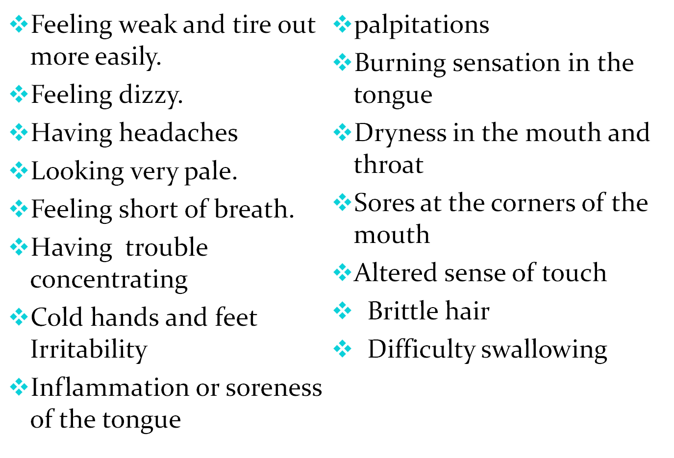
Signs and symptoms of IDA

Slide 19
s/s
Unusual cravings for non-nutritive substances, such as ice, dirt or starch
Poor appetite, especially in infants and children
An uncomfortable tingling or crawling feeling in the legs (restless legs syndrome)
Brittle, spoon-shaped nails with vertical stripes and a tendency to fray

Slide 20
Treatment of iron deficiency anaemia
1. Iron supplements that contain the ferrous form of iron are recommended which the body can absorb easily. If one uses iron supplements, remember the following cautions:
Excess iron intake can be harmful. Symptoms of iron overload include fatigue, vomiting, diarrhoea, headaches, irritability and joint problems

Slide 21
IDA treatment
Iron supplements - Iron poisoning is a major cause of accidental poisoning in young children. Eating even a few tablets can prove fatal in a matter of hours. Symptoms of poisoning in a child include dizziness, confusion, nausea, vomiting, and diarrhoea. Seek medical help immediately
2. Good dietary sources of iron include red meat, beans, egg yolk, whole-grain products, nuts and seafood
3.In rare cases, the doctor may prescribe iron injections or recommend to have iron intravenously .
4.In extremely rare cases of life-threatening iron-deficiency anaemia, treatment may involve blood transfusion.

Slide 22
For vitamin B-12 and folate deficiency anaemia
The treatment depends on the cause of the deficiency. If the body stores are depleted of vitamin B12, the doctor is most likely to prescribe vitamin B12 injections. If the vitamin B12 levels are borderline low then the doctor may try oral tablets in a high dose first to see the response
Prevention of IDA
by eating a well-balanced diet that includes good sources of iron, vitamin B12 and folate.
If you are a vegetarian, talk to your doctor or a nutritionist about your diet and any possible need for supplements

Slide 23
Prevention of IDA
Ask the doctor or nutritionist if you should take vitamin C. Vitamin C makes the stomach more acidic and can improve the absorption of iron in your diet
Decrease the consumption of caffeinated products and tea. These substances can decrease iron absorption. Other offenders include the preservative EDTA, fibre, large amounts of calcium, and the phytates found in some vegetables
Select iron-fortified cereals and breads
Carefully follow safety guidelines if your occupation involves work with lead-containing materials such as batteries, petroleum, and paint
Ask the doctor or local public-health authorities about lead-testing the kitchenware you use for food or beverage preparation

Slide 24
Pernicious Anemia and Vitamin B-12 Deficiency
Pernicious anemia is a disease where large, immature, nucleated cells (megaloblasts, which are forerunners of red blood cells) circulate in the blood, and do not function as blood cells; it is a disease caused by impaired uptake of vitamin B-12 due to the lack of intrinsic factor (IF) in the gastric mucosa. It was termed "pernicious" because before it was learned that vitamin B-12 could treat the anemia, most people that developed the disease died from it.

Slide 25
Causes of pernicious anaemia
Pernicious anemia is due to an inability to absorb vitamin B-12 (also known as cobalamin or Cbl) from the gastrointestinal tract. Humans get vitamin B-12 from animal products; both meat and dairy products are dietary sources of vitamin B-12. The body is able to store vitamin B-12 for a long time, so inadequate dietary intake must persist for years before a true deficiency of vitamin B-12 is reached

Slide 26
ct
Autoimmune disease. It is believed that the decreased absorption of vitamin B-12 from the gastrointestinal tract in pernicious anemia results from the presence of an autoantibody against intrinsic factor (IF), a protein made in the stomach that is necessary for the absorption of vitamin B-12. Normally, vitamin B-12 binds to intrinsic factor in the stomach, and this facilitates its absorption by the small intestine further along in the digestive process. Along with the autoimmune process that attacks the IF protein and lowers IF levels in stomach secretions, another autoimmune reaction against the stomach lining cells also occurs, resulting in a form of inflammation known as chronic atrophic gastritis.

Slide 27
Megaloblastic anemia
Megaloblastic anemia refers to an abnormally large type of red blood cell (megaloblast). Megaloblasts are produced in the bone marrow when vitamin B-12 or folic acid levels are low.
Causes
Megaloblastic anemia can also be caused by other disease of the bone marrow and can be a side effect of some cancer chemotherapy drugs.

Slide 28
Vitamin B-12 deficiency anemia
Causes
Causes of vitamin B-12 deficiency include surgical removal of the stomach or a portion of the stomach (total or partial gastrectomy), other gastrointestinal diseases such as celiac disease or crohn’s disease, infections of the gastrointestinal tract, and poor nutrition.

Slide 29
Diagnosis
Signs and symptoms
A full heamogram
Blood vitamin B-12 level measurements
Tests for the presence of auto antibodies to intrinsic factor or stomach lining cells
Blood levels of iron and iron-binding capacity
Folate levels (which are often reduced when vitamin B-12 levels are low)
Blood levels of methylmalonic acid or homocytes both of which may be sensitive indicators of vitamin B-12 deficiency
The Schilling test, a measure of how well the body can absorb vitamin B-12, is less commonly used today than in the past.
Finally, bone marrow aspirate or biopsy may be recommended in some cases if bone marrow disorders are suspected

Slide 30
Treatment for pernicious anemia and vitamin B-12 deficiency
If a condition other than pernicious anemia is responsible for vitamin B-12 deficiency, treatment must also be directed at the underlying condition
Vitamin B-12 is typically given as an intramuscular injection .An injection of 1 mg of vitamin B-12 is generally given every day for one week, followed by 1 mg every week for four weeks and then 1 mg every month thereafter

Slide 31
Prevention
The autoimmune process that causes pernicious anemia cannot be prevented. Vitamin B-12 deficiency that is caused by conditions such as other gastrointestinal diseases and gastrointestinal surgery is preventable only to the extent that these causative conditions themselves are preventable.
Vitamin B-12 is derived from animal (for example, meat, fish, poultry, milk) sources, but vitamin B-12 deficiency in vegetarians or vegans can be prevented by the use of oral vitamin B-12 supplements. An oral dose of 100-200 mg taken weekly is sufficient. Pregnant and nursing women who are vegetarians should take a vit B-12 supplement and inform their doctors they are vegetarians .

Slide 32
Sickle Cell Anemia
Sickle cell anemia (sickle cell disease) is a disorder of the blood caused by an inherited abnormal heamoglobin .The abnormal hemoglobin causes distorted (sickled) red blood cells. The sickled red blood cells are fragile and prone to rupture. When the number of red blood cells decreases from rupture (hemolysis), anaemia is the result. The irregular sickled cells can also block blood vessels causing tissue and organ damage and pain.

Slide 33
How sickle cell anemia is inherited
Sickle cell anemia is inherited as an autosomal (meaning that the gene is not linked to a sex chromosome) recessive condition whereas sickle cell trait is inherited as an autosomal dominant trait. This means that the gene can be passed on from a parent carrying it to male and female children. In order for sickle cell anemia to occur, a sickle cell gene must be inherited from both the mother and the father, so that the child has two sickle cell genes.

Slide 34
Sickle cell
The inheritance of just one sickle gene is called sickle cell trait or the "carrier" state. Sickle cell trait does not cause sickle cell anemia. Persons with sickle cell trait usually do not have many symptoms of disease and have normal hospitalization rates and life expectancies.
When two carriers of sickle cell trait mate, their offspring have a one in four chance of having sickle cell anemia.
The sickled red blood cells are prone to breakage (rupture) which causes a much shorter life span of these cells.

Slide 35
Typically, the site of red blood cell production (bone marrow) works overtime to produce these cells rapidly, attempting to compensate for their destruction in the circulation. Occasionally, the bone marrow suddenly stops producing the red blood cells which causes a very severe form of anemia (aplastic crises)

Slide 36
Conditions that promote the sickling (distortion) of the red blood cells in sickle cell anemia
Conditions which are associated with low oxygen levels, increased acidity, or low volume (dehydration )
of the blood. These conditions can occur as a result of injury to the body's tissues, dehydrating states, or anesthesia.
Even certain organs are predisposed to lower oxygen levels or acidity, such as when blood moves slowly through the spleen, liver, or kidney. Also, organs with particularly high metabolism rates (such as the brain, muscles, and the placenta in a pregnant woman with sickle cell anemia) promote sickling by extracting more oxygen from the blood.

Slide 37
Sickle cell anemia diagnosis
Sickle prep_Testing is typically performed on a smear of blood using a special low-oxygen preparation
Prenatal diagnosis (before birth) of sickle cell anemia is possible using amniocentesis or chorionic villus sampling.The sample obtained is then tested for DNA analysis of the fetal cells.
The hemoglobin electrophoresis test precisely identifies the hemoglobins in the blood by separating them

Slide 38
Symptoms of sickle cell anemia
Fatigue and Anemia
Pain Crises-Pain crises in persons with sickle cell anemia are intermittent painful episodes that are the result of inadequate blood supply to body tissues. The impaired circulation is caused by the blockage of various blood vessels from the sickling of red blood cells. The sickled red blood cells slow or completely impede the normal flow of blood through the tissues
Dactylitis (swelling and inflammation of the hands and/or feet) and arthritis.Dactylitis is caused by injury to the bones of the affected digits by repeated episodes of inadequate blood circulation
Bacterial Infections

Slide 39
s/s of sca
Splenic Sequestration (sudden pooling of blood in the spleen) and Liver Congestion
Lung and Heart Injury
Leg Ulcers
Aseptic necrosis and Bone Infarcts (death of portions of bone)
Eye Damage

Slide 40
Treatments of sickle cell anemia
The treatment of sickle cell anemia is designed according to which of the individual features of the illness are present. In general treatment is directed at the management and prevention of the acute manifestations as well as therapies directed toward blocking the red blood cells from stacking together.
Fatigue and Anemia
The sickled red blood cells are prone to breakage (rupture) which causes a much shorter life span of these cells . Occasionally, there can be a severe drop in hemoglobin requiring a blood transfussion to correct the anemia .

Slide 41
Pain Crises
Pain crises in persons with sickle cell anemia are intermittent painful episodes that are the result of inadequate blood supply to body tissues. The impaired circulation is caused by the blockage of various blood vessels from the sickling of red blood cells. The sickled red blood cells slow or completely impede the normal flow of blood through the tissues
A pain crisis can be promoted by preceding dehydration, infection, injury, cold exposure, emotional stress or strenuous exercise. As a prevention measure, persons with sickle cell anemia should avoid extremes of heat and cold.

Slide 42
Pain crises
The pain typically is throbbing and can change its location from one body area to another. Bone is frequently affected. Pain crises require medications for pain and increased fluid intake.
Hydroxyurea is a medication that is currently being used in adults and children with severe pain from sickle cell anemia. This drug acts by increasing the amount of fetal hemoglobin in the blood (this form of hemoglobin is resistant to sickling of the red blood cells). Hydroxyurea can be toxic to the bone marrow.

Slide 43
Dactylitis and Arthritis
The inflammation from dactylitis and arthritis can be reduced by anti-inflammation medications, such as iboprofen and asprin.
Bacterial Infection
Lung infection (pneumonia) is extremely common in children with sickle cell anemia. Vaccination against pneumococcal infection is generally recommended. Early detection and antibiotic treatment are the keys to minimizing complications.
The liver is often firm and can become tender. Impaired liver function can result in jaundice. The gallbladder, which drains bile from the liver, can fill with gall stones .Inflammation of the gallbladder (cholecystitis) can cause nausea and vomiting and require its removal.

Slide 44
Splenic Sequestration and Liver Congestion
The spleen is commonly enlarged (splenomegaly) in younger children with sickle cell anemia. As the spleen is repeatedly injured by damage from impaired blood supply, it gradually shrinks with scarring. Impairment of the normal function of the spleen increases the tendency to become infected with bacteria. Sudden pooling of blood in the spleen (splenic sequestration) can result in a very severe anemia and death. These patients can develop shock and lose consciousness. Transfusion of blood and fluids can be critical if this occurs

Slide 45
Lung and Heart Injury
Repeated pulmonary infarcts can lead to scarring of the lungs of children with sickle cell anemia by the time they reach adolescence’
The heart is frequently enlarged in children with sickle cell anemia. Rapid heart rates and murmurs are common. The heart muscle can also be injured by infarcts and iron depositing in the muscle as it leaks from the ruptured red blood cells.
Leg Ulcers- This seems to be a result of the stagnant blood flow caused by the sickled red blood cells. Injury to the skin of the legs or ankles can promote skin damage and ulceration.
Oral antibiotics and topical creams are often used

Slide 46
Aseptic Necrosis and Bone Infarcts
Inadequate circulation of the blood, which is characteristic of sickle cell anemia, also causes areas of death of bone tissue (bone infarction). Aseptic necrosis, or localized bone death, is a result of inadequate oxygen supply to the bone. Aseptic necrosis is also referred to as osteonecrosis.
most common are the bones of the thighs, legs, and arms. Pain, tenderness, and disability frequently are signs of aseptic necrosis. Painful bone infarcts can be relieved by rest and pain medications.
Aseptic necrosis can permanently damage large joints (such as the hips or shoulders), worsening of the condition can be prevented by avoiding weight bearing.

Slide 47
Eye Damage
Impairment of the circulation from the sickling of red blood cells results in damage to the retina (retinopathy). The result can be partial or complete blindness.
Bleeding can also occur within the eye (retinal hemorrhage) and retinal detachment can leading to blindness.
Preventative measures, such as laser treatments, can be used if bleeding into the eye and retinal detachment are detected early.

Slide 48
Other Features
weakening of bones from osteoporosis, kidney damage and infection, and nervous system damage. Osteoporosis can lead to severe pain in the back and deformity from collapse of the bony building blocks (vertebrae) of the spine. Kidney damage can lead to poor kidney function with a resulting imbalance of blood sodium and acidity.
Poor blood circulation in the brain can cause stroke,convulsions, and coma,-Transfusion of blood and fluids intravenously can be critical. Medications to reduce the chance of seizures are sometimes added.
Pripiasm an abnormally persistent erection of the penis in the absence of sexual desire, can occur in persons with sickle cell anemia. Priapism can lead to impotence

Slide 49
Prognosis
The life expectancy of persons with sickle cell anemia is reduced. Some patients, however, can remain without symptoms for years, while others do not survive infancy or early childhood.
Most patients suffer intermittent pain crises, fatigue, bacterial infections, and progressive tissue and organ damage. Impaired growth and development is the end result of the physical and emotional trauma that is endured by children with sickle cell anemia.
Causes of death include bacterial infection (the most common cause), stroke or bleeding into the brain, and kidney, heart, or liver failure.

Slide 50
LEUKEMIA
Leukemia is cancer of the blood cells
The bone marrow starts to make a lot of abnormal white blood cells.
They don't do the work of normal white blood cells, they grow faster than normal cells, and they don't stop growing when they should.
Over time, leukemia cells can crowd out the normal blood cells. This can lead to serious problems such as anaemia, bleeding, and infections. Leukemia cells can also spread to the lymph nodes or other organs and cause swelling or pain.

Slide 51
Types according to progression
It may be acute or chronic. Acute leukemia gets worse very fast and may make you feel sick right away. Chronic leukemia gets worse slowly and may not cause symptoms for years.
It may be lymphocytic or myelogenous.Lymphocytic (or lymphoblastic) leukemia affects the lymphocytes. Myelogenous leukemia affects the myelocytes.
The four main types of leukemia are:
Acute lymphoblastic leukemia, or ALL.
Acute myelogenous leukemia, or AML.
Chronic lymphocytic leukemia, or CLL.
Chronic myelogenous leukemia, or CML

Slide 52
Epidemiology
In adults, chronic lymphocytic leukemia (CLL) and acute myelogenous leukemia (AML) are the most common leukemias. In children, the most common leukemia is acute lymphoblastic leukemia (ALL). Childhood leukemias also include acute myelogenous leukemia (AML) and other myeloid leukemias, such as chronic myelogenous leukemia (CML) and juvenile myelomonocytic leukemia (JMML).

Slide 53
Causes leukemia
Idiopathic
Risk factors
Radiation : -Atomic bomb explosions, radiotherapy,diagnostic x-rays
Benzene-widely used in the chemical industry. It's also found in cigarette smoke and gasoline.
Chemotherapy
Down syndrome
Myelodysplastic syndrome and certain other blood disorders
Human T-cell leukemia virus type I (HTLV-I)
Family history

Slide 54
Symptoms
Headaches
Bruising or bleeding easily
Bone or joint pains.
A swollen or painful or discomfort in the abdomen from an enlarged spleen
Swollen lymph nodes in the armpit, neck, or groin that usually don't hurt.
Getting Frequent infections
Feeling very tired or weak.
Weight loss for no known reason
Anaemia and bleeding.
Night sweats, and unexplained fevers.

Slide 55
Symptoms
Acute leukemia: The leukemia cells can't do any of the work of normal white blood cells. The number of leukemia cells increases rapidly. Acute leukemia usually worsens quickly.
Chronic leukemia: Early in the disease, the leukemia cells can still do some of the work of normal white blood cells. People may not have any symptoms at first. Doctors often find chronic leukemia during a routine checkup - before there are any symptoms.

Slide 56
Diagnosis
Through history taking
Physical exam
high level of white blood cells and low levels of other types of blood cells.
Bone marrow biopsy /Bone marrow aspiration
Cytogenetics-chromosomes of cells from samples of blood, bone marrow, or lymph nodes.
Chest X-rays-show swollen lymph nodes

Slide 57
Treatment
The options are watchful waiting, chemotherapy, targeted therapy, biological therapy, radiation therapy, and stem cell transplant or surgery.
Biological therapy is the use of special medicines that improve the body's natural defenses against cancer.
Side effects of chemotherapy
Destroy blood cells, alopecia, GIT disturbance,can cause infertility.

Slide 58
THROMBOCYTOPENIA
Thrombocytopenia is a lower than normal number of platelets in the blood.
Platelet counts less than 150,000 are termed thrombocytopenia. Platelet counts greater that 450,000 are called thrombocytosis.
Causes of thrombocytopenia
Decreased platelet production,
Increased platelet destruction or consumption, or
Increased splenic sequestration

Slide 59
Decreased platelet production
Decreased platelet production is usually related to a bone marrow problem (agranulocytosis)
Viral infections affecting the marrow for example
  Parvovirus,rubella, mumps,varicella(chickenpox), hepatitis c, epstein –barrvirus and HIV
chemotherapy
Leukemia or cancers of the lymph nodes (lymphoma)
Long term alcohol can cause direct toxicity of the bone marrow.
Deficiency of vitamin B12 and folic acid

Slide 60
Increased platelet destruction or consumption
They can be divided into immune related and non-immune related causes
Drug-induced thrombocytopenia eg sulfonamide, carbamazepine, quinine , tylenol and rifambicin, heparin
Idiopathic thrombocytopenic purpura
Rheumatologic condition, such as systemic lupus erythematosus
Transfusion of blood, DIC, vasculatis, sepsis
Thrombotic thrombocytopenic purpura
Artificial heart valves

Slide 61
Splenic sequestration
Chronic liver diseases eg cirrhosis,hepatitis, blood cancer
Dilutional thrombocytopenia can result from severe bleeding and transfusion of several units transfused red blood cells in a short time.
Pseudothrombocytopenia due to clumping of platelets together

Slide 62
Symptoms of thrombocytopenia
may have no symptoms, especially if mild
Severe manifest as increase bleeding when a person is cut or injured or increased bleeding during menses
Spontaneous bleeding (the inner lining of the oral cavity, gastrointestinal tract, or the nasal cavity)
Purpura and Petechiae

Slide 63
Diagnosis of thrombocytopenia
Full blood count
Physical examination and medical history of the patient eg cancers, leukemia, family history etc
Treatment of thrombocytopenia
largely dependent upon the cause and the severity of the condition.
If auto-immune thrombocytopenia or ITP, steroids can be used to weaken the immune system in order to impair the attack on platelets
In more severe cases, intravenous immunoglobulins (IVIG) or antibodies may also be given to slow down the immune process
Splenectomy

Slide 64
Complications of thrombocytopenia
hemorrhage and major blood loss.
heparin induced may cause thrombosis

